Slide 1


Hannds on Pytorch and Tensorflow
Eng/ Mahmoud Yasser Hammam

Slide 2
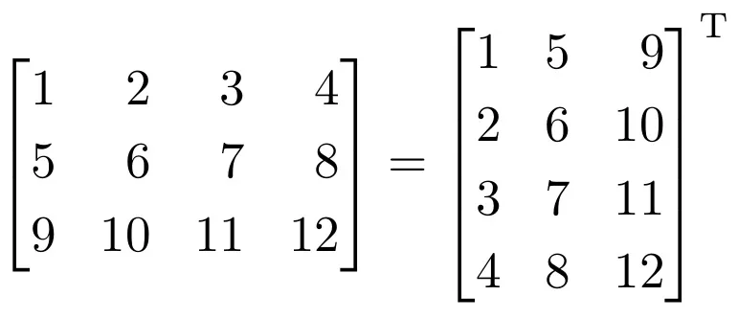
Section 1 Matrix Transpose

Slide 3
Test Yourself

Slide 4
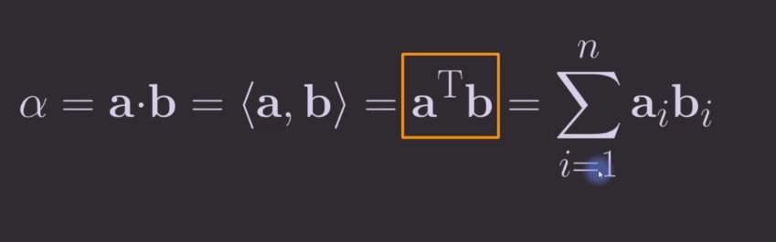
Section 2: Dot Product

Slide 5
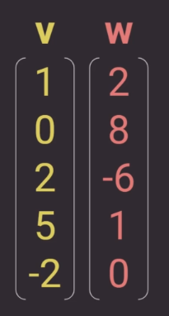
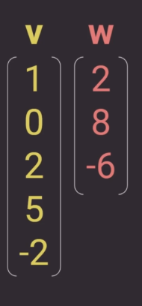
V(T)W = 1*2+0*8+2*-6+5*1+-2*0
= 2 – 12 + 5
= -5
V(T)W = 1*2+0*8+2*-6+5*?+-2*?

Slide 6
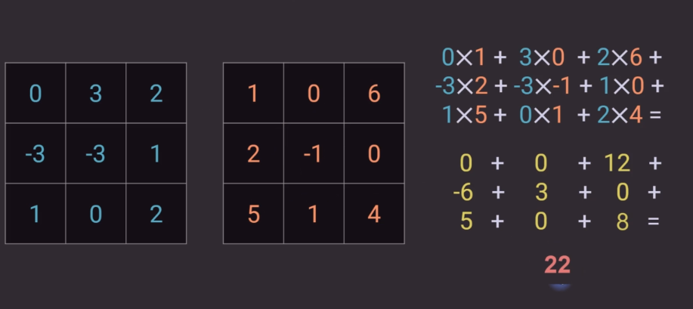
Product in 2D

Slide 7
Test yourself
Make a pytorch program to multiply these two arrays

Slide 8
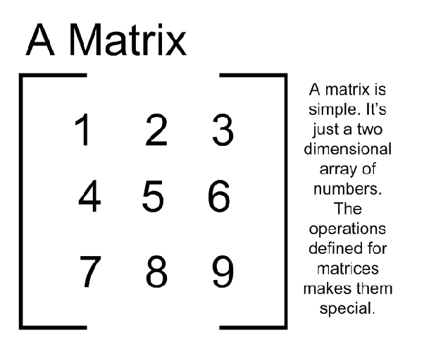
Section 3: Matrix Multiplication

Slide 9
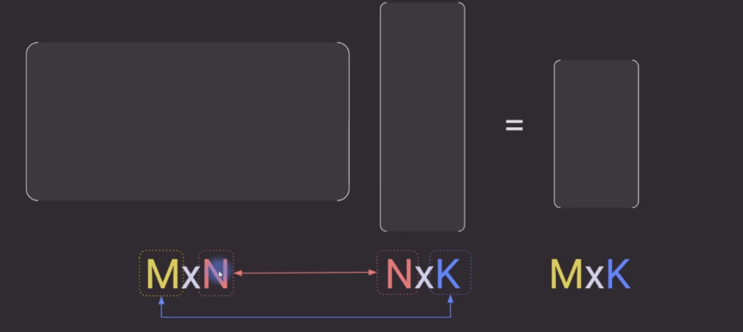
Matrix multiplication rule

Slide 10
Examples
A B B A
5x2 2x7 2x7 5x2

Slide 11
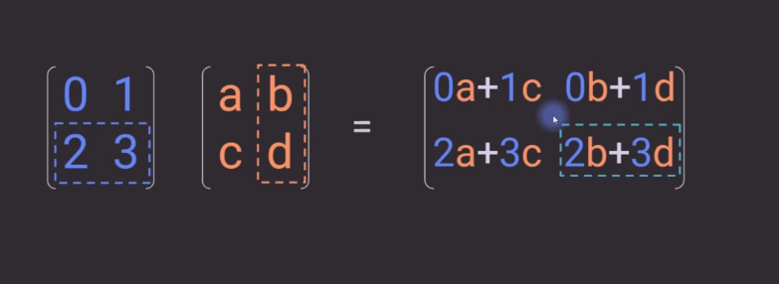
How to multiply matrix

